Slide 1


DermaSense AI
Intelligent Skin Health, Disease Detection & Personalized Beauty Care Assistant
Presented By
SUBIKSEN V S (2303811710421160)
S UMAN S (2303811710421161)
SURYA P (2303811710421163)
TAMIL MUGILAN D (2303811710421163)
Under the Guidance of
Ms. S. KEERTHANA
ASSISTANT PROFESSOR,
DEPT OF CSE,
KRCT.

Slide 2

CONTENTS
PROBLEM IDENTIFICATION
ABSTRACT
OBJECTIVES AND SCOPE OF THE PROJECT
EXISTING SYSTEM
PROPOSED SYSTEM
ARCHITECTURE DIAGRAM OF PROPOSED SYSTEM
METHODOLGY & ALGORITHM DESCRIPTION
HARDWARE AND SOFTWARE REQUIREMENTS/TECHNOLOGY STACK
UI SCREENS/WIRE FRAMES

Slide 3
PROBLEM IDENTIFICATION
Problem Statement
1.Skin diseases and skincare problems are increasing due to pollution, unhealthy lifestyles, stress, and environmental factors. Many people delay consulting 2.dermatologists because of high costs, lack of awareness, or limited access.
3.Current skincare apps mainly provide product suggestions but fail to detect possible skin diseases or monitor skin health over time.
Challenges
1.Lack of early skin disease screening
2.Difficulty in identifying skin type
3.No personalized skincare routine
4.Limited progress tracking
5.No environmental skin analysis
6.Generic skincare recommendations
7.Lack of AI-powered assistance

Slide 4
ABSTRACT
1.DermaSense AI is an AI-powered mobile application that combines skin disease screening with intelligent skincare assistance.
2.The system analyzes facial or skin images using Artificial Intelligence to detect common skin conditions, evaluate overall skin health, and generate personalized skincare recommendations.
3.It also tracks skin improvement over time, recommends skincare products based on ingredients, analyzes environmental factors affecting skin health, and supports dermatologist consultation.
4.The application serves as an AI-assisted skin health companion and encourages users to seek professional medical advice whenever necessary.

Slide 5
OBJECTIVES
1.Detect common skin diseases using AI
2.Analyze skin quality and overall skin health
3.Recommend personalized skincare routines
4.Suggest suitable skincare products
5.Track skin improvement over time
6.Provide AI-powered skincare assistance
7.Improve awareness of skin diseases
8.Encourage early dermatologist consultation

Slide 6
SCOPE OF THE PROJECT
Scope
The application is designed for both healthcare and beauty care users.
It can
Detect common skin diseases
Analyze acne, pigmentation, pores, wrinkles and hydration
Recommend skincare products
Monitor long-term skin progress
Store digital skin records
Support dermatologist consultation
Provide multilingual support
Deliver AI-powered skincare education
Future enhancements include wearable device integration and advanced dermatology
AI models.

Slide 7
EXISTING SYSTEM
Current skincare applications generally provide
Basic skin analysis
Generic skincare tips
Manual symptom checking
Product advertisements
Some disease detection systems only classify diseases without offering skincare
guidance or progress tracking.

Slide 8
LIMITATIONS OF EXISTING SYSTEM
No personalized skincare routine
Limited disease detection
No AI beauty analysis
Lack of progress monitoring
No environmental impact analysis
Generic product recommendations
Limited explainability of AI predictions
No integrated dermatologist support

Slide 9
PROPOSED SYSTEM
Proposed System
DermaSense AI integrates Artificial Intelligence, Computer Vision, and Mobile Computing into a single platform.
The application provides
AI skin disease detection
Skin health analysis
Personalized skincare routines
AI product recommendation
Lifestyle analysis
Environmental skin monitoring
Progress tracking
AI chatbot
Dermatologist consultation support

Slide 10
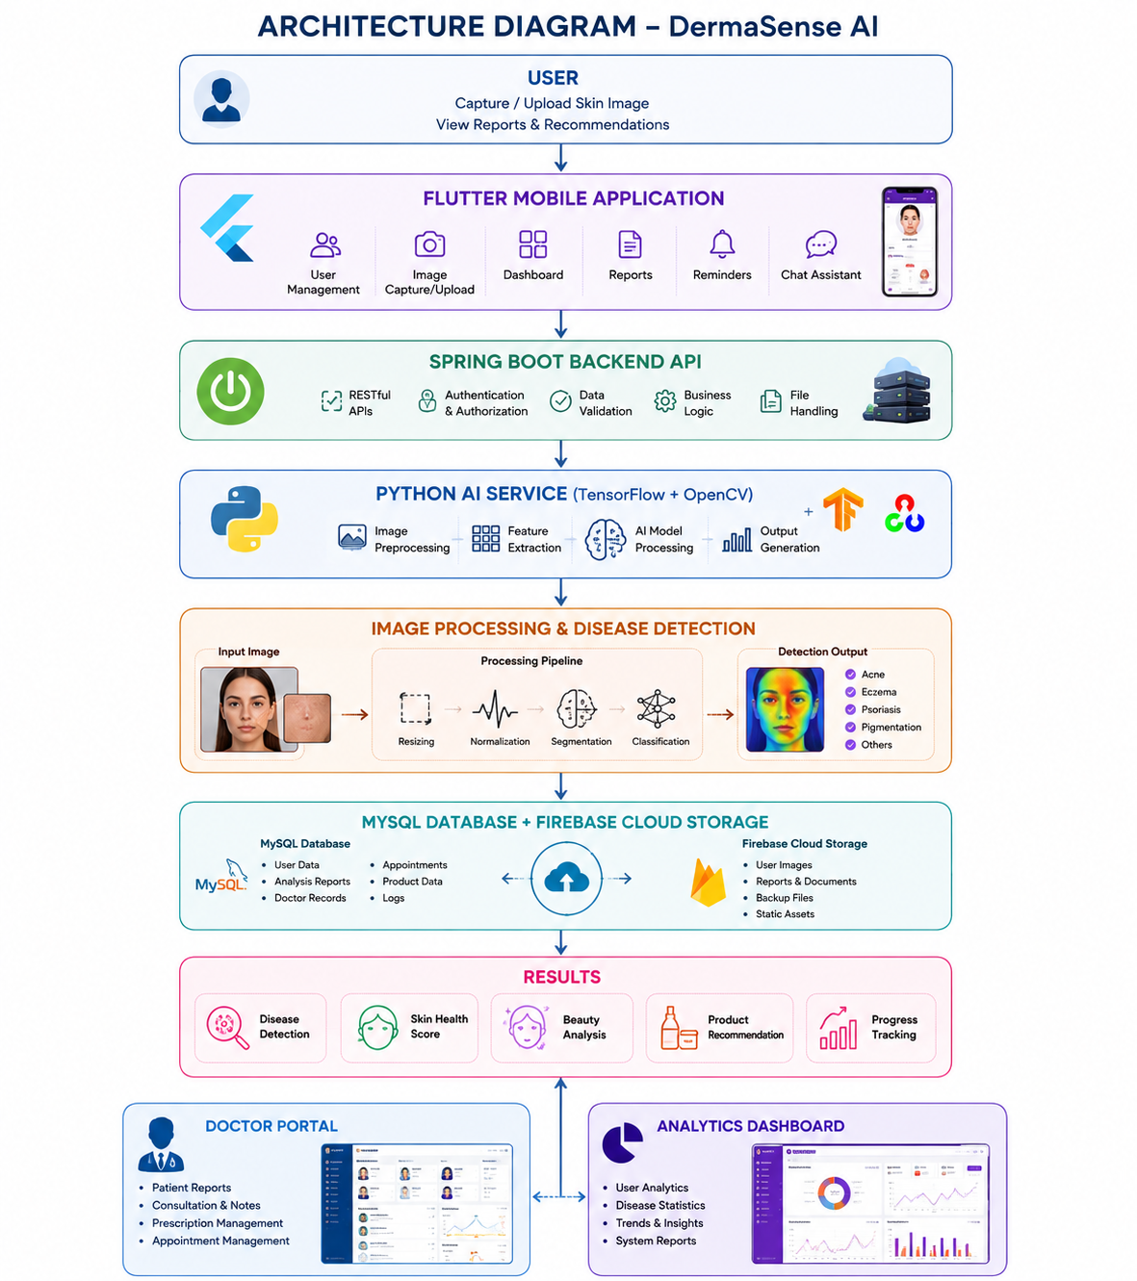
ARCHITECTURE DIAGRAM OF PROPOSED SYSTEM

Slide 11
ADVANTAGES OF PROPOSED SYSTEM
Early AI-assisted disease screening
Personalized skincare recommendations
Beauty and healthcare combined
Explainable AI heatmaps
Digital skin journal
Lifestyle-based recommendations
Progress monitoring
Secure cloud storage
Doctor consultation support
User-friendly mobile interface

Slide 12
METHODOLOGY USED
Development Methodology
Agile Methodology
Development Phases
Requirement Analysis
Literature Survey
UI Design
Backend Development
AI Model Training
Integration
Testing
Deployment
Maintenance

Slide 13
ALGORITHM DESCRIPTION
Workflow
User logs into the application.
User uploads or captures a skin image.
Image preprocessing is performed.
AI model extracts image features.
Disease detection model predicts possible skin condition.
Skin quality analysis is performed.
AI calculates Skin Health Score.
Personalized skincare routine is generated.
Product recommendation engine suggests suitable products.
Results are stored for future comparison.

Slide 14
TECHNOLOGY STACK
Layer | Technology
Frontend | Flutter
Backend | Spring Boot
AI Service | Python (FastAPI/Flask)
AI Models | TensorFlow / PyTorch
Image Processing | OpenCV
Database | MySQL
Cloud Storage | Firebase
Notifications | Firebase Cloud Messaging
Maps | Google Maps API
Version Control | Git & GitHub

Slide 15
UI SCREENS/WIRE FRAMES
Include mockups/screenshots of
Login Screen
Registration Screen
Home Dashboard
Camera Upload Screen
AI Analysis Result
Skin Health Report
Product Recommendation Page
Progress Tracking Page
AI Chat Assistant
Doctor Appointment Screen

Slide 16
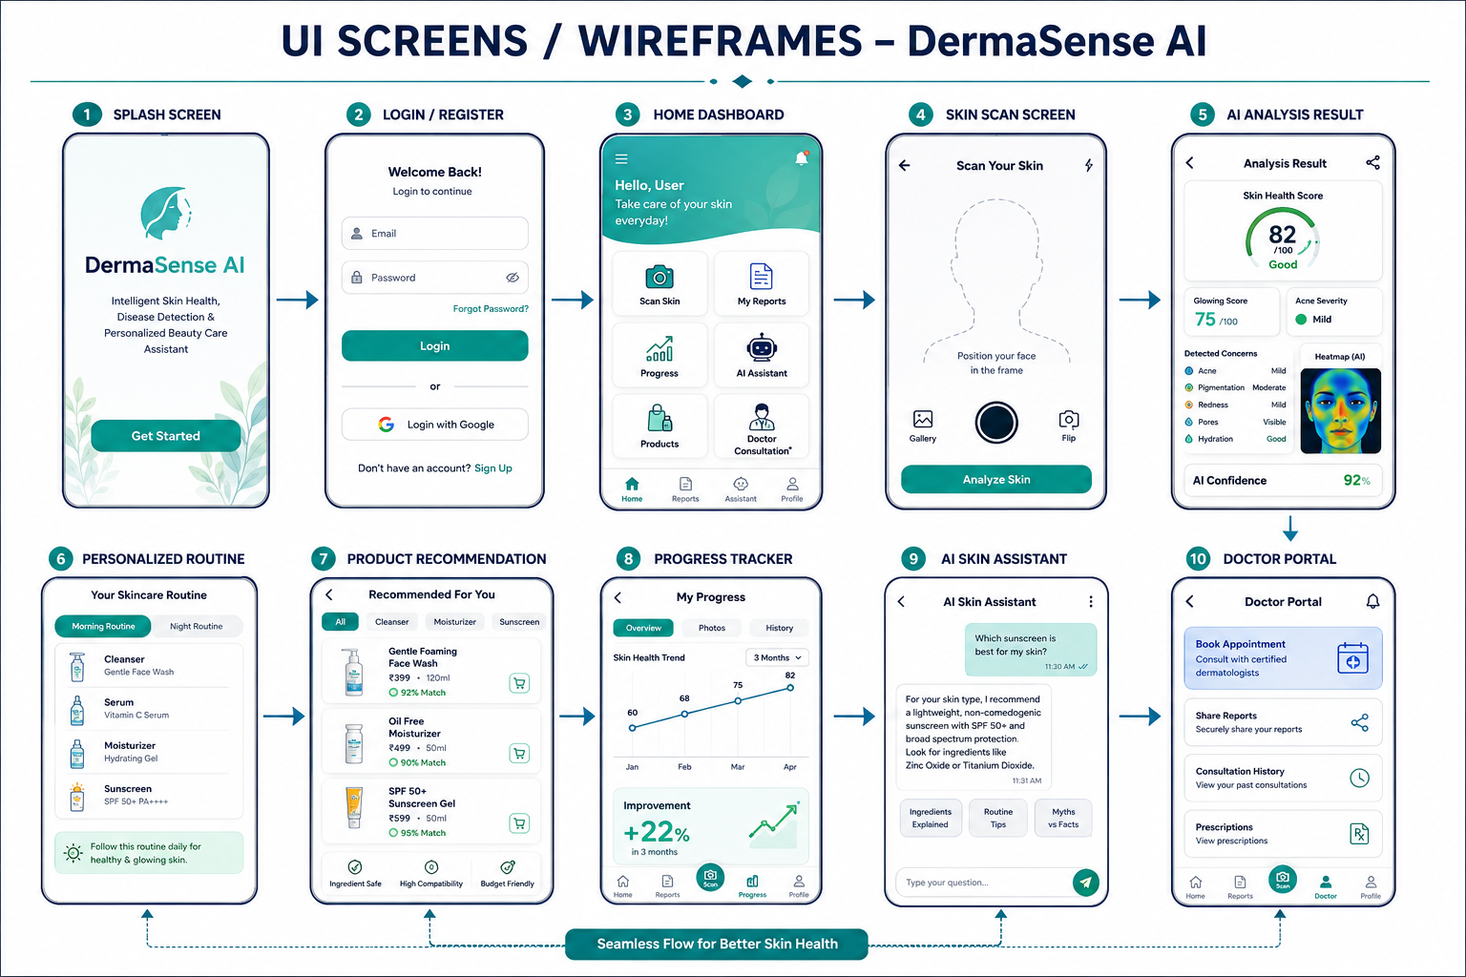
UI SCREENS/WIRE FRAMES

Slide 17
Queries ????

